Slide 1

Resume builder
Batch no:25
S. Ishani-211419104107
V. Madhumitha-211419104157
GUIDE:
MRS.P.VIJAYALAKSHMI

Slide 2
INTRODUCTION
The primary goal of the program that makes the process of making a Resume for individuals more easier.
The method is simple to use and eliminates the need to consider and construct an appropriate resume based on qualifications.
The system was created to make it simple to create a professional-looking resume.
Individuals must simply complete a form that includes questions from all needed fields, including personal questions, educational questions, traits, interests, and skills, among others.
The answers given by the users are saved, and the system generates a well-structured résumé automatically.
Users can produce resumes in any format and file type.

Slide 3
Literature survey
YEAR OF PUBLISHING | TITLE OF THE PAPER | AUTHOR | ABSTRACT | LINK
2019 | Web Application for Screening Resume | Sujit Amin, Nikita Jayakar, Sonia Sunny | This paper focuses majorly on the design of the web application which will be used to screen resumes (Curriculum Vitae) for a particular job posting. In the proposed system, a web application will encourage the job applicant candidates as well as the recruiters to use it for job applications and screening of resumes. Recruitment is a tedious process wherein the first task for any recruiter is to screen the resumes. The proposed web application is designed in such a way that job applicant as well as recruiters can use it with ease for applying for job openings and screening respectively. | https://ieeexplore.ieee.org/document/8945869

Slide 4
Literature survey
YEAR OF PUBLISHING | TITLE OF THE PAPER | AUTHOR | ABSTRACT | LINK
2020 | Analytical Resume Builder – A web Application for creating a resume which gives a best impact in this competitive world. | Bharti Kungwani , Amisha Manglani, Naman Dembal, Hiten Hirani, Laveen Sawlani | A resume is a document that contains a summary or listing of relevant job experience and education.The list of qualifications or CV is normally the principal thing that a potential business experiences with respect to the work searcher and is regularly used to screen candidates, frequently followed by a meeting, when looking for business Our program does the reasoning and composing for you. In the job search process, a well-written and well-designed résumé is essential. Our program does the thinking and writing for you. | https://annalsofrscb.ro/index.php/journal/article/view/8908/6491

Slide 5
Literature survey
YEAR OF PUBLISHING | TITLE OF THE PAPER | AUTHOR | ABSTRACT | LINK
2021 | RESUME BUILDER APPLICATION | Shreekanth Marapaka, Ms. Shweta Ramteke | A resume is a document used by individuals to present their background and skill sets. A resume also spelled resume or resume also called curriculum vitae or CV. A document that has a brief summary or listing about relevant education and experience. The resume or CV is typically the first item that a potential user encounters regarding the job seeker and is mostly used for screening an applicant’s which is often followed by an interview, while seeking employment in the job search process and well-designed resume. The Resume Builder will help user build his/her personal advertisement through Resume Builder system develop a resume builder with job placement system | https://www.jetir.org/view?paper=JETIREN06004

Slide 6
Literature survey
YEAR OF PUBLISHING | TITLE OF THE PAPER | AUTHOR | ABSTRACT | LINK
2022 | RESUME BUILDER WITH CLASSIFIER | Rishil Shah, Vishal Patel, Hriday Lal | This gadget proposes a version of extracting vital facts from the semi-dependent textual content layout in a curriculum vitae or resume and rating it in step with the desire of the related corporation’s company’s requirements. In order to obtain the very last and preferred end , the complete procedure has been divided into three one-of-a-kind segments. The number one phase includes segmenting the complete CV / Resume primarily based totally on the subject of every part. The 2nd phase consists of extracting facts in dependent shape from the unstructured facts. The very last phase includes comparing the very last dependent facts with the aid of using a choice tree set of rules and via means of educating the device. | https://www.irjmets.com/uploadedfiles/paper//issue_5_may_2022/22272/final/fin_irjmets1651835517.pdf

Slide 7
Literature survey
YEAR OF PUBLISHING | TITLE OF THE PAPER | AUTHOR | ABSTRACT | LINK
2022 | Survey Paper on Resume Building Applications | Kishor Raut , Suhas Dalve , Mahesh Jadhav , Harish Koli | Nowadays getting a good job is a vigorous and vast competition and many fail in the first step i.e., Resume shortlisting due to either imperfect data in the resume or imperfect/wrong resume format. Recruiter hardly takes 10-15 seconds to judge you upon your resume. In this survey paper, we point out a comparative study on different methods used for resume building and which technology is used to build them. Some of the methods use Android applications, some use Desktop applications. This paper makes a detailed analysis and talks about the merits and demerits of various Resume building methods. Keywords: Android applications, Desktop applications, Recruiter, Vigorous, Vast. | https://www.ijraset.com/best-journal/survey-paper-on-resume-building-applications

Slide 8
PROBLEM STATEMENT
The existing system is creating resumes manually either by using word or Google doc so there are some issues with the existing system. The existing system was suffering from a series of drawbacks. Since the whole of the system was to be maintained with hands the process of keeping, maintaining and retrieving the information was very tedious and lengthy. The records were never used to be in a systematic order there used to be lots of difficulties in associating any particular transaction with a particular context If any information was to be found it was required to go through the different registers, documents there would never exist anything like report generation There would always be unnecessary consumption of time while entering records and retrieving records One more problem was that it was very difficult to find errors while entering the records Once the records were entered it was very difficult to update these records.

Slide 9
environment
Hardware Requirements
CPU : Pentium 4, 1.7 GHZ
RAM : 512Mb
Hard disc : 80 GB

Slide 10
environment
Software Requirements
Operating System : Windows 2000/xp-sp2
Back -End :
Front -End : JSP
Browser : IE 7

Slide 11
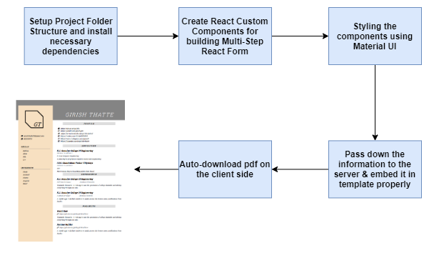
System architecture

Slide 12
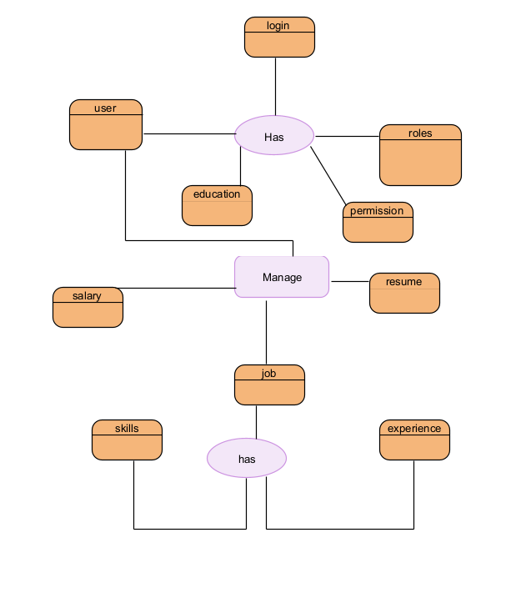
System design
ER-DIAGRAM:

Slide 13
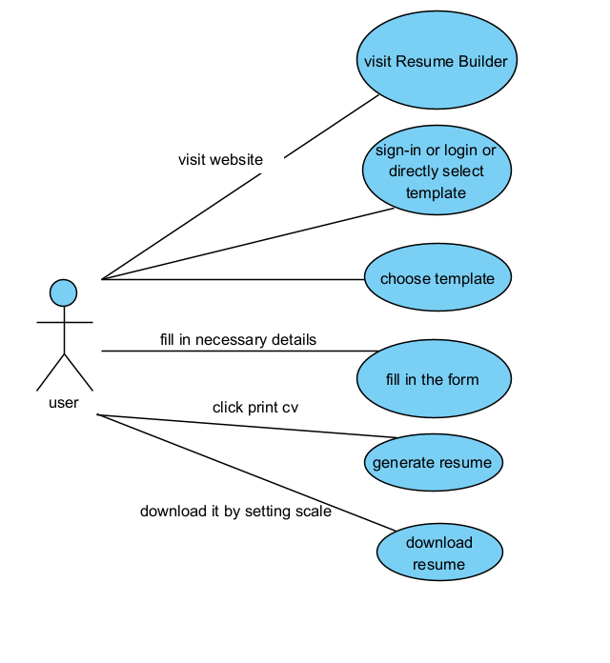
System design
USECASE:

Slide 14
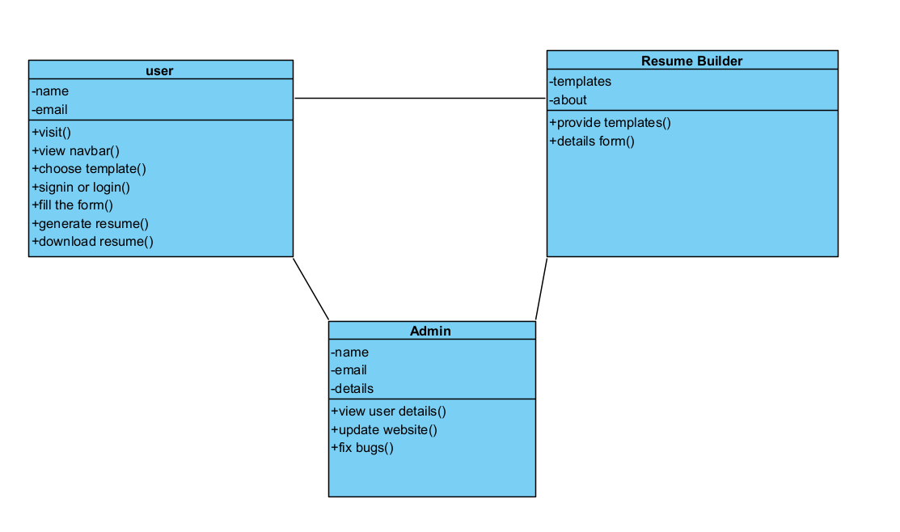
System design
CLASS-DIAGRAM:

Slide 15
Modules DESCRIPTION
USER MODULE This module is mainly dedicated to the candidates who are looking for resumes. They can log in into the system, via the credentials provided to them & once they are in, they have to choose a format of the resume which they like the most & have to fill the online form where different questions relevant to their resume will be asked. They can download the resume from the same module, in any file format they required.
RESUME BUILDING MODULE Many different samples of the resumes will be attached here. Users can check this module, from their module and choose any kind of resume they are looking for. Different designs of resumes for different professionals can be seen here. Candidates can also change the fonts and other styles as per their requirements in this module.

Slide 16
Modules DESCRIPTION
3. ADMIN MODULE This module is maintained by the admin and only he/she can manage and have access to every account. Admin can add or delete the format of the resumes as well. They can modify the functionalities of the system, too. Admin can also add users on the fly to the application to make the application full of new functionalities. Admin will be like super use having control over each and everything which make application more secure and with single security control.

Slide 17
Existing system
If someone wants to make his/her resume, then he/she have to look for every single detail such as formatting, alignment, designs, patterns.
So, it is a very complex process and thus, the productivity of the resume also decreases.
Many websites that are related to this charge a fee for membership.
The existing system is very complex and making resume via word files and excels is a tough task.
Sometimes, while making a resume, a person ends up forgetting some very crucial information while going through all these designs and formats.

Slide 18
Proposed system
A person merely needs to fill out the questions asked by the website in the proposed Online resume builder.
All of the resume's additional alignments and formats are handled by the system directly.
Even yet, the final resume that was produced is quite professional and meets industry standards, and the candidate can download it in the file format that he or she prefers.
This eliminates the need for manual work when writing a resume.
This is a no-cost service.

Slide 19
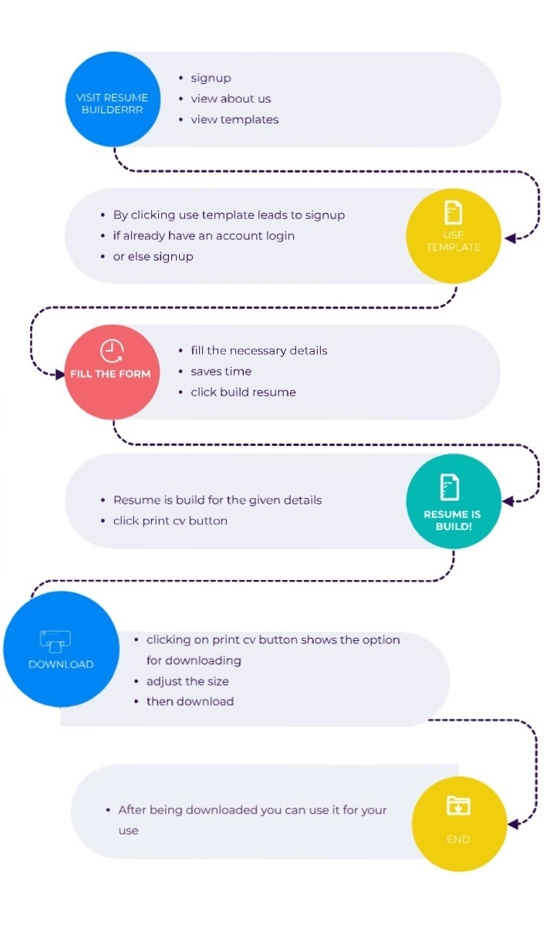
workflow

Slide 20
TESTING
TEST CASE NO | ACTION | EXPECTED OUTPUT | ACTUAL OUTPUT | RESULT
1 | Click create resume | Enters to template | Enters to template | Pass
2 | Click signup | Enters to signup page | Enters to signup page | Pass
3 | Fill the form | Details filled | Details filled | Pass
4 | Click PrintCV | Resume downloaded | Resume downloaded | Pass

Slide 21
Testing strategies
In order to make sure that the system does not have errors, the different levels of testing strategies that are applied at differing phases of software development are:
Unit Testing
Integration Testing
System Testing
Acceptance Testing
Testing Approaches: 2 ways
Bottom up Approach
Top Down Approach

Slide 22
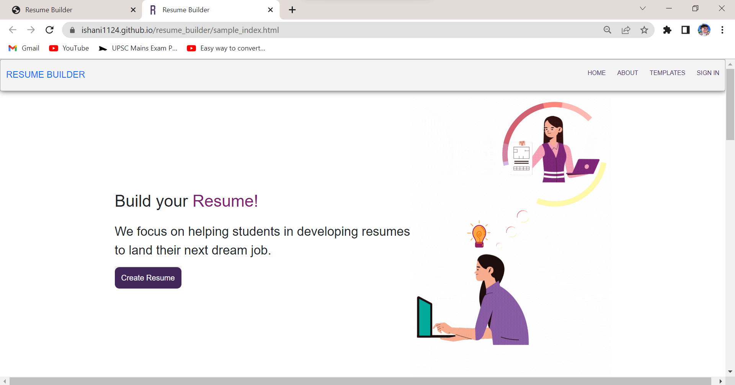
screenshots
Website

Slide 23
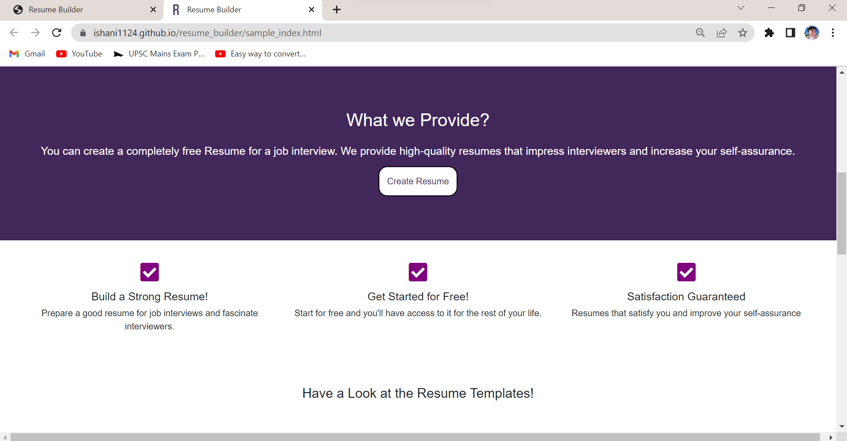
screenshots
Website

Slide 24
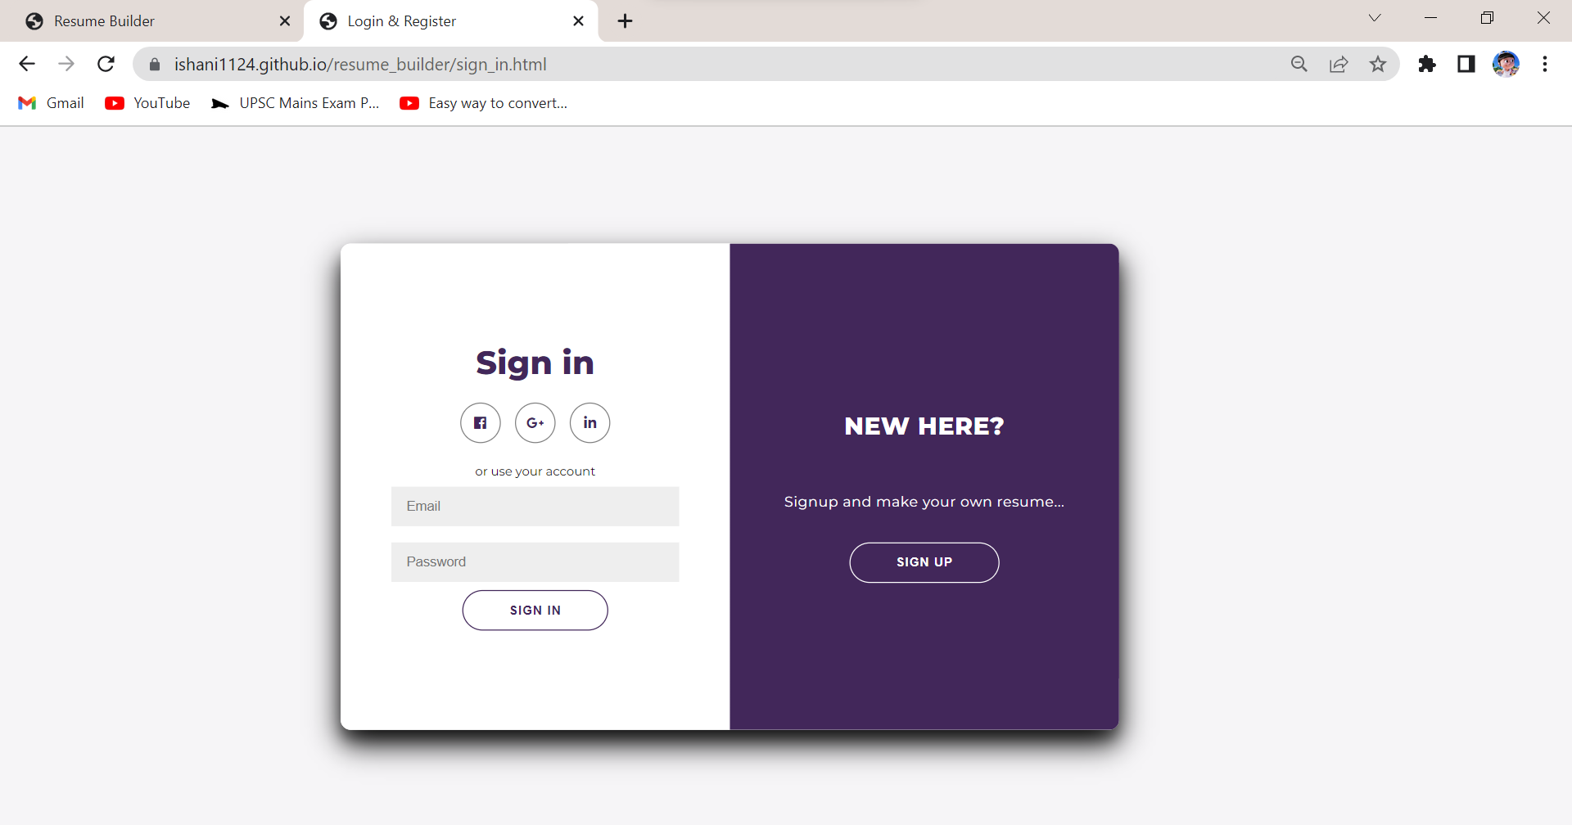
screenshots
Sign in

Slide 25
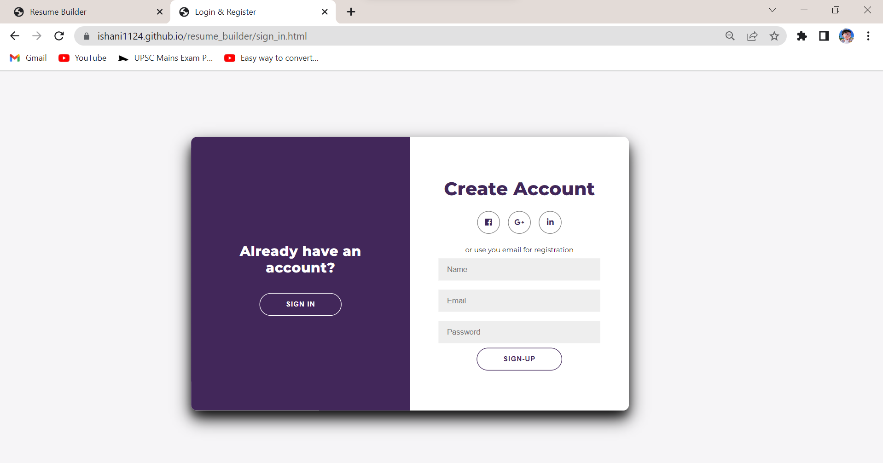
screenshots
Login

Slide 26
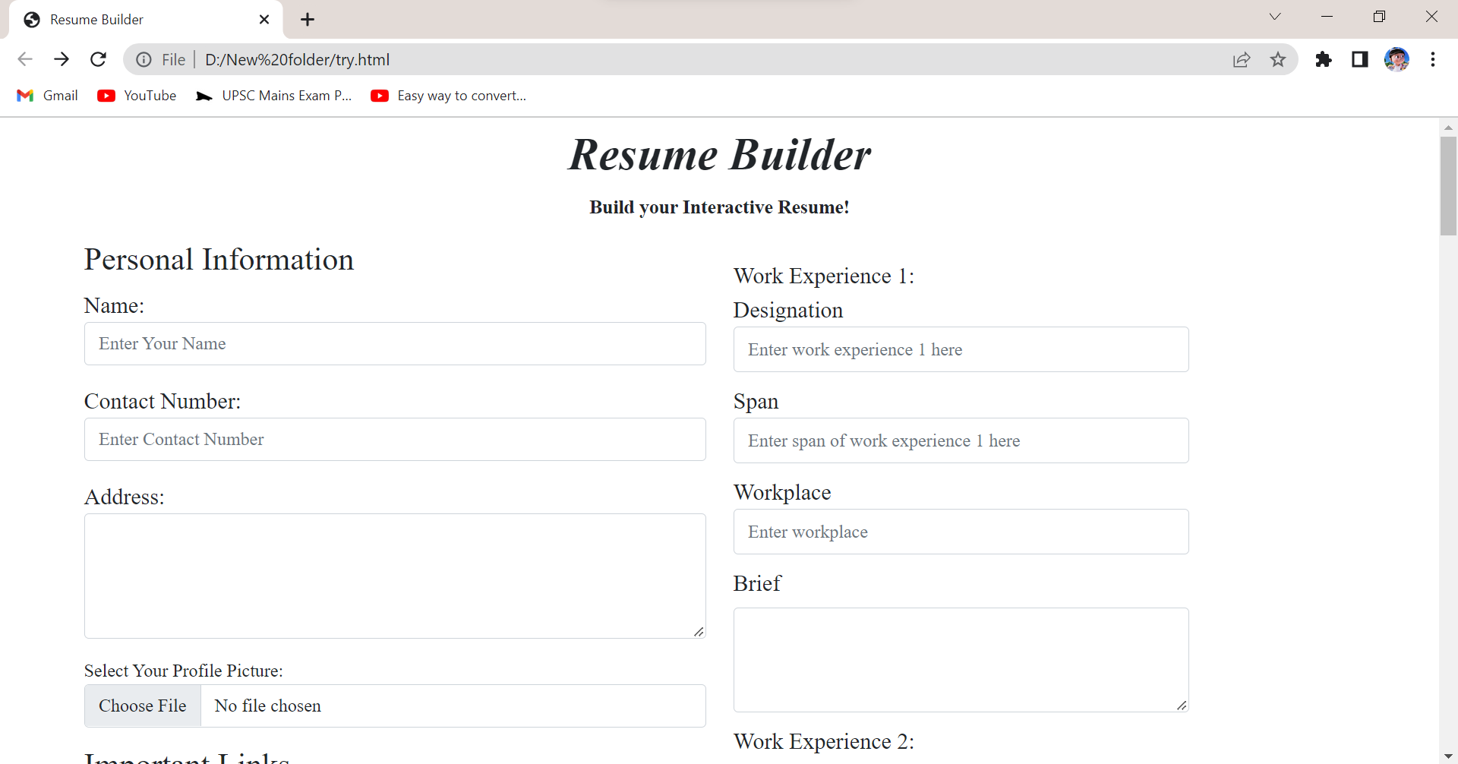
screenshots
Form

Slide 27
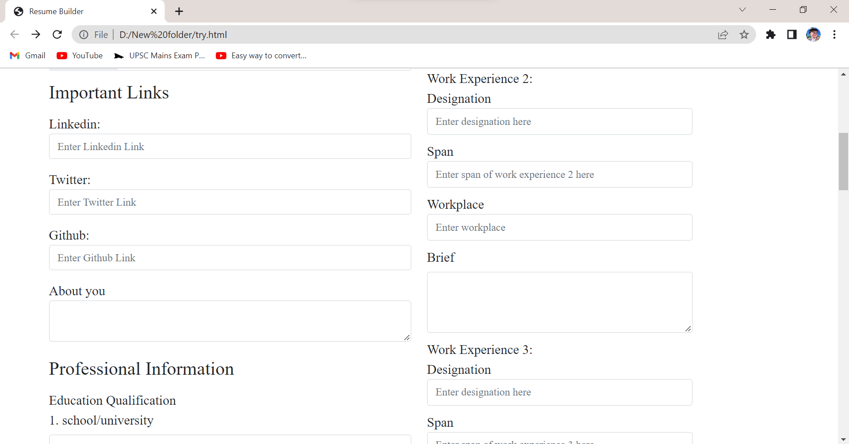
screenshots
Form

Slide 28
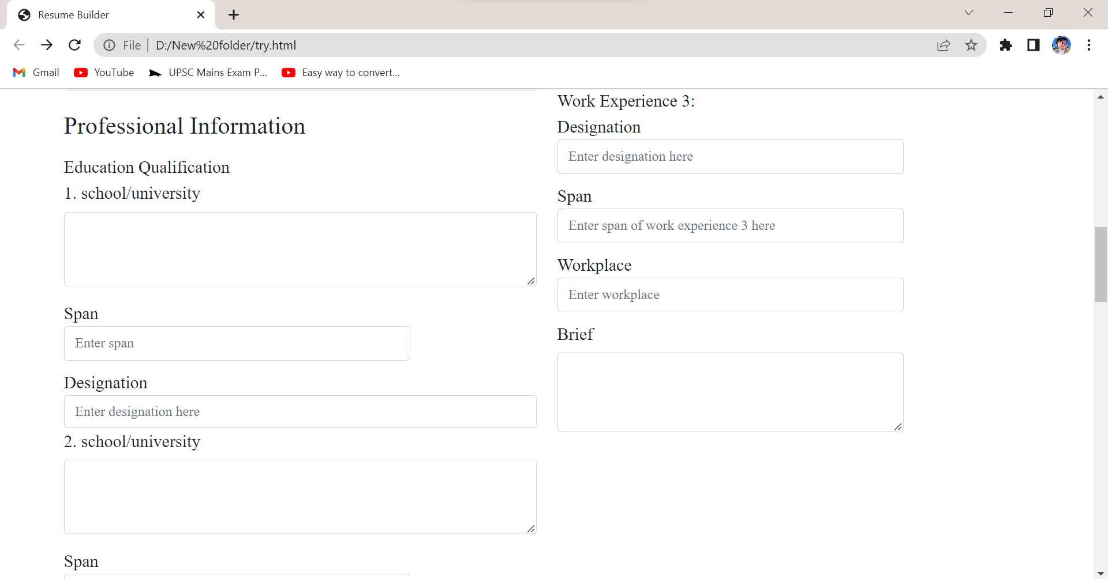
screenshots
Form

Slide 29
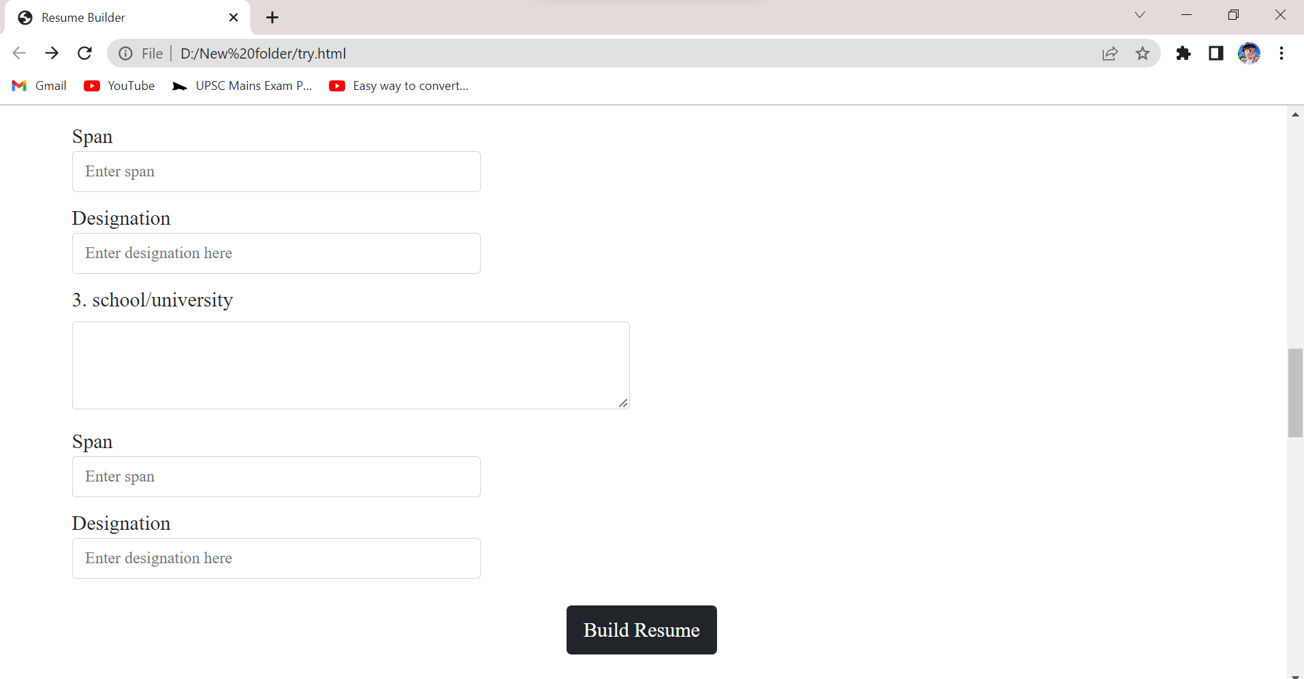
screenshots
Form

Slide 30
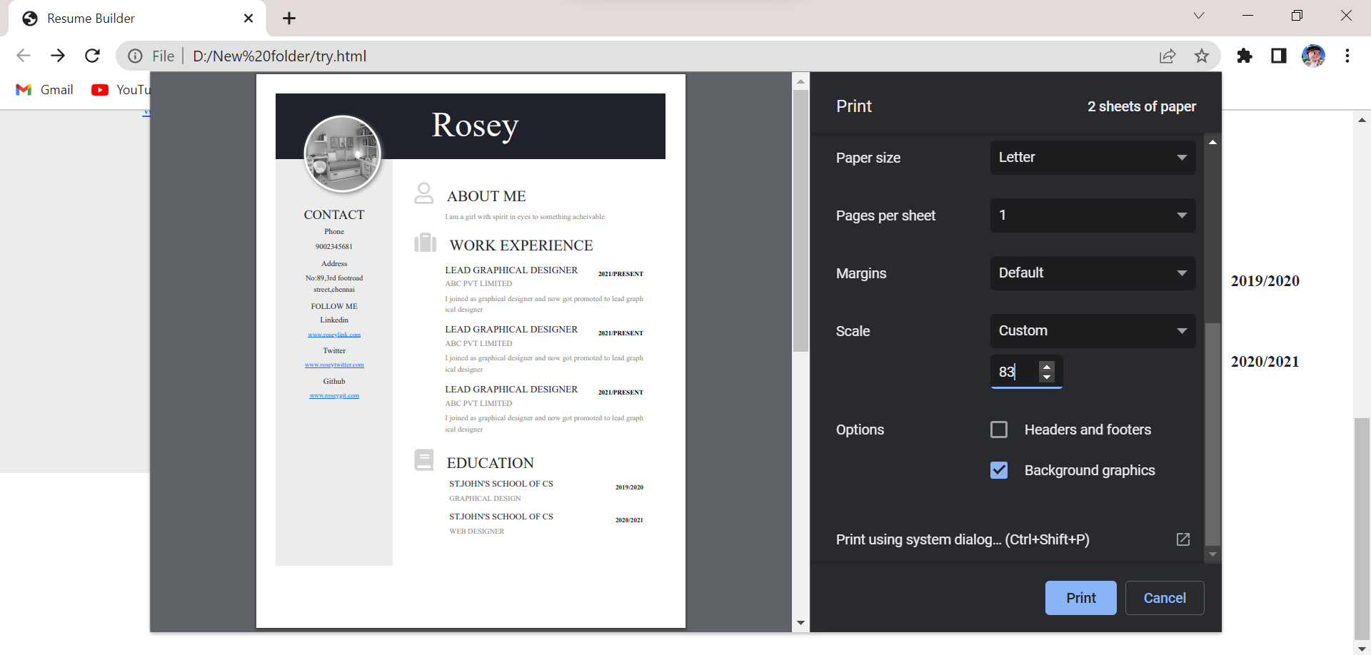
screenshots
Build Resume

Slide 31
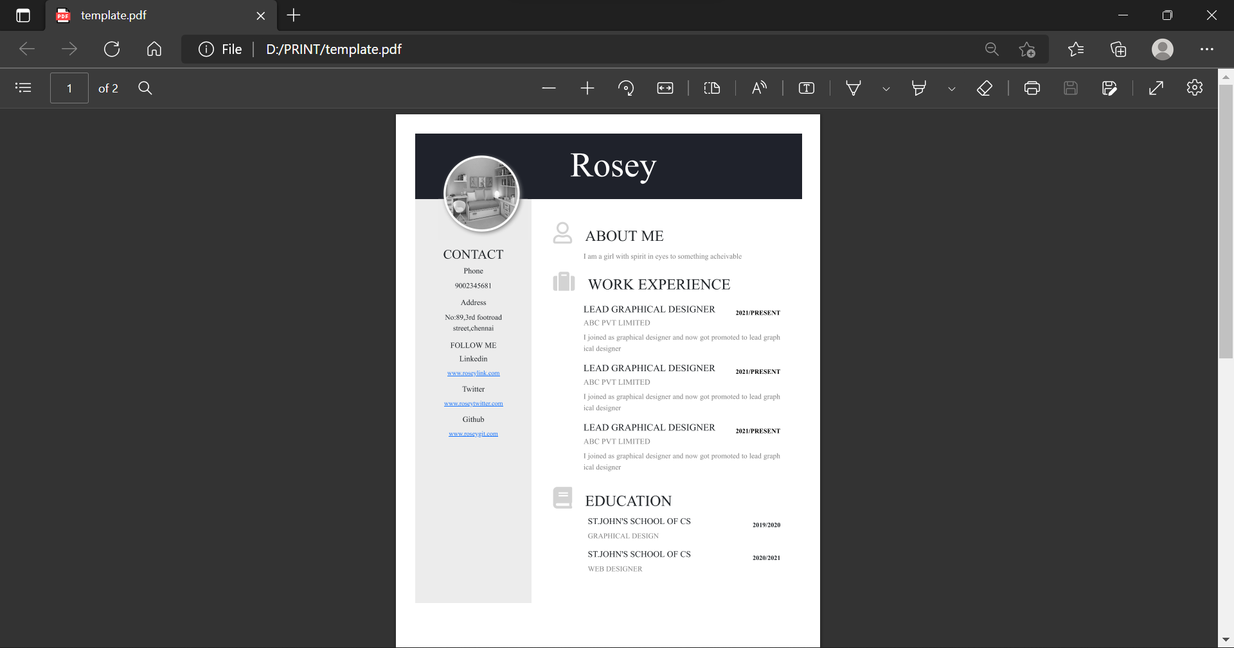
screenshots
Downloaded Resume

Slide 32
CONCLUSION
Our goal with this project is to encourage people to pick a template, fill out the form, and create their own resume. This makes the user more easier to create their resume

